Slide 1
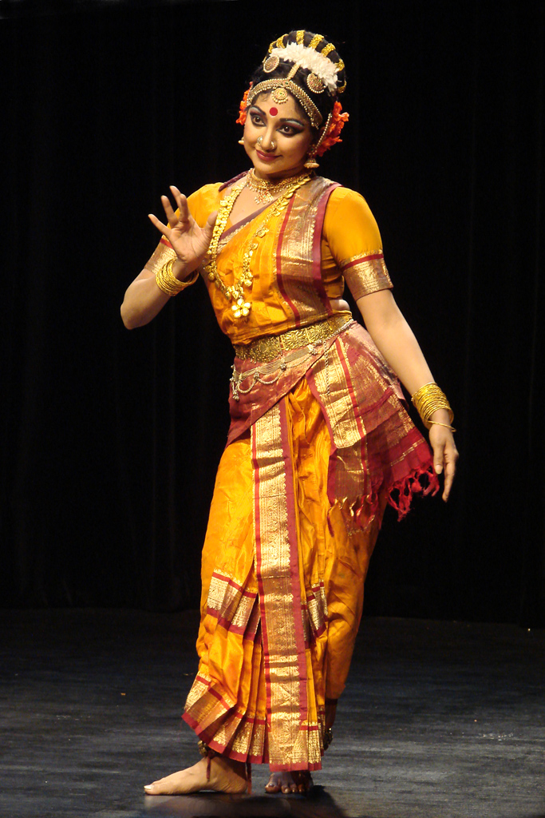
Telugu (తెలుగు)
A bit of other South Indian languages
Notes:
Andharika Namaskaram! Na peru Usha. Evala manam Telugu gurunchi chudam. Ikada mana chala mandi students unnaru! Enta mandi o konchum chey lepandi!

Slide 2
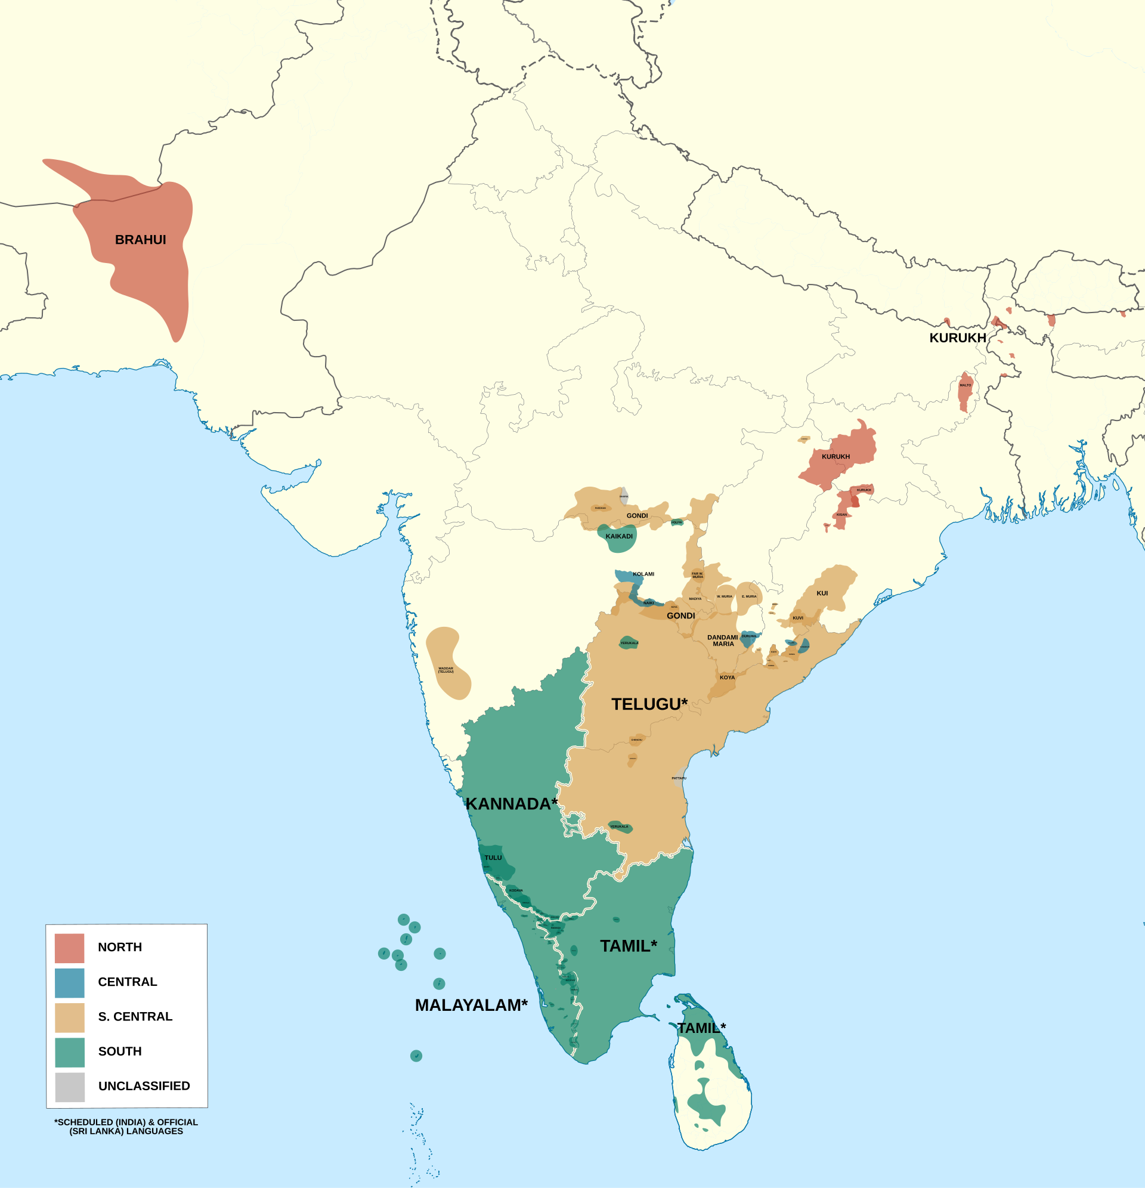
Where and Why?
One of the 6 classical languages of India
14th most spoken language in the world
96 million native speakers
Dravidian language family
Native to Andhra Pradesh & Telangana
Diaspora has taken it around the globe, thanks to software developers (my folks love math, software, movies and staying understated)
A Credentialed Community Language (CCL) in Australia
By Noahedits - Own work, CC BY-SA 4.0, https://commons.wikimedia.org/w/index.php?curid=86838148

Slide 3

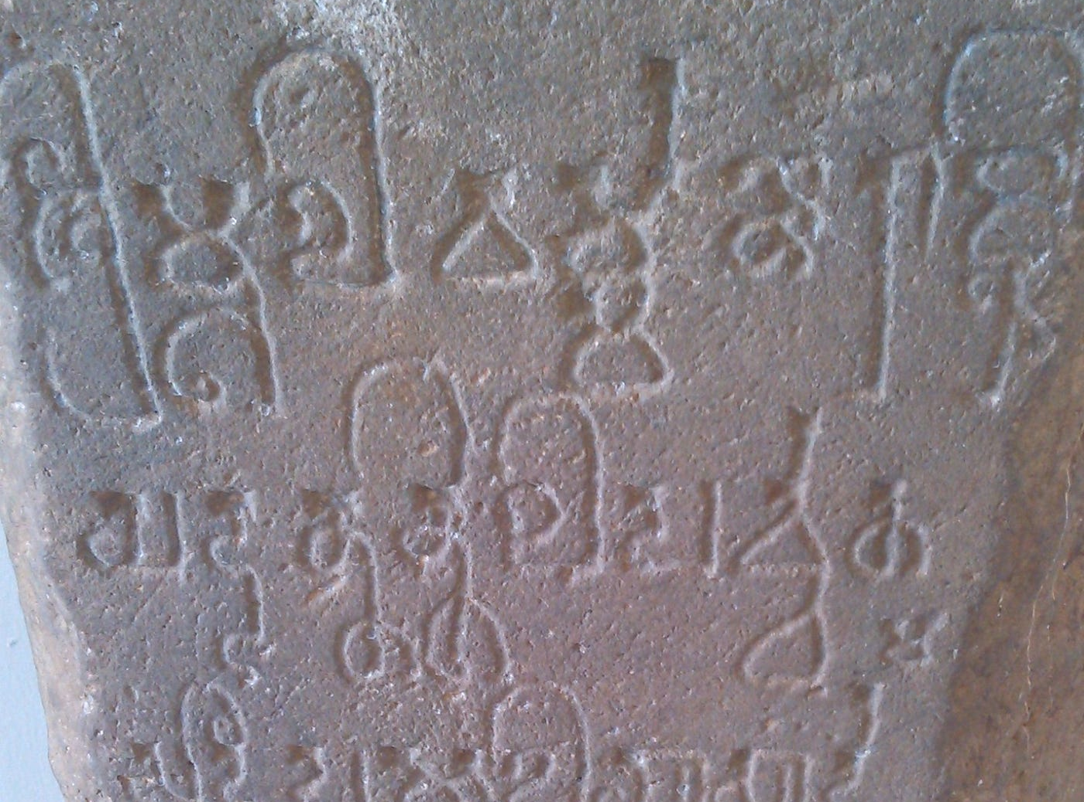
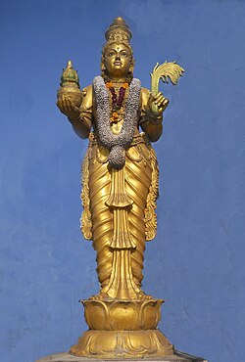
History of Telugu
Split from proto-Dravidian at 1000 BC, first rock inscription dates from 4th century BC.
Megasthenes, the Greek Seleucid ambassador to India in the 4th century BC, in his Indica mentions that Andhras living between the Krishna and Godavari rivers were tall with long hair and were militarily very strong with several fortified cities.
Inscriptions found as far away as Indonesia and Myanmar, recalling a golden age of South Indian and South-east Asian maritime heritage. Languages like Thai, Lao and Khmer were deeply influenced by old Indian languages.
Language of high culture and strong contributor to the Carnatic music tradition (India has 2 music traditions, one South Indian Carnatic and the other North Indian Hindustani).

Slide 4
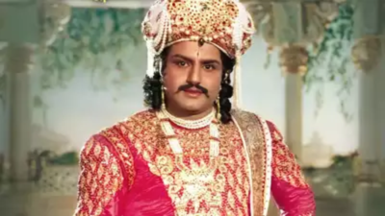
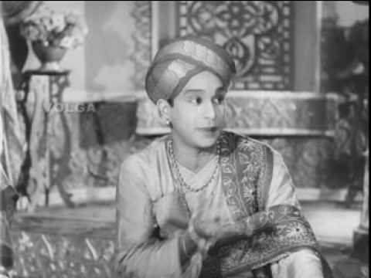
Evolved through a 1000 years of Literature
Many kingly dynasties like the Satavahanas, Ikshvakus and Kaktiyas, zenith at the Vijayanagara empire of King Sri Krishnadeva Raya (1509-1529), a very generous patron of arts, someone who is as fondly remembered as King Arthur or Robin Hood might be elsewhere.
Literature and poetry flourished in both Hindu and Buddhist tradition.
Once when I was younger, poetry and oral prose recitals were very common even at village-levels but it’s turning a bit rare of late. You wouldn’t be considered civilized if you couldn’t quote atleast a few poems.
If you ask me, the floweriness gets overdone sometimes! What sounds like a charming word-play in Telugu can come across as verbose and over the top in English.
King Krishnadeva Raya and his witty court jester Tenali Rama have inspired countless stories of wit and social justice in India. Historically, both were authors of repute, along with the other literary giants sponsored by the king.

Slide 5
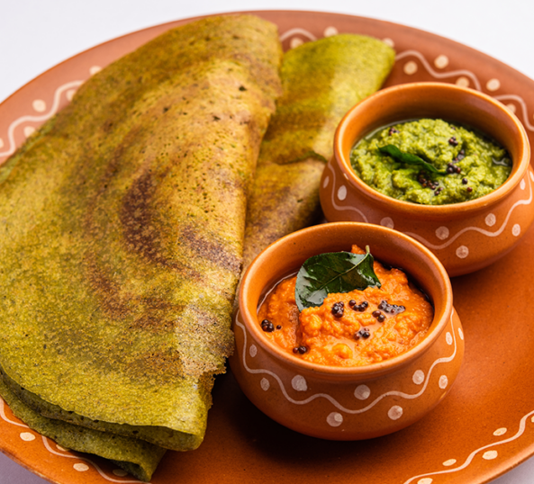
Telugu language

Slide 6
Telugu as a language
చేయటం (to do)
చేయలేకపోయినవారికి (addressed to those people who can’t do)
చేయలేకపారిపోయినవారికి (addressed to those people who ran away because they couldn’t do)
Can get however long you like :/
ధూమచక్రశకటఆగమననిర్గమననివాసస్థలము
dhuma-chakra-sakata-agamana-nirgamana-nivasa-stalamu
Pretty long winded for a railway station, no one would even know what it meant….
Highly agglutinative, words can stack together in chained suffixes and prefixes to form highly nuanced words.
There are native words and there are words loaned from Sanskrit, so something might have two words for it, a rough-sounding native one and a sweet-sounding classical one.
(buva/truva -> annamu/neeru)
The classical version usually exists in literature, the everyday version people use is easier on the brain and tongue, though not as poetic.
Very expressive in nuance like most Asian languages.

Slide 7
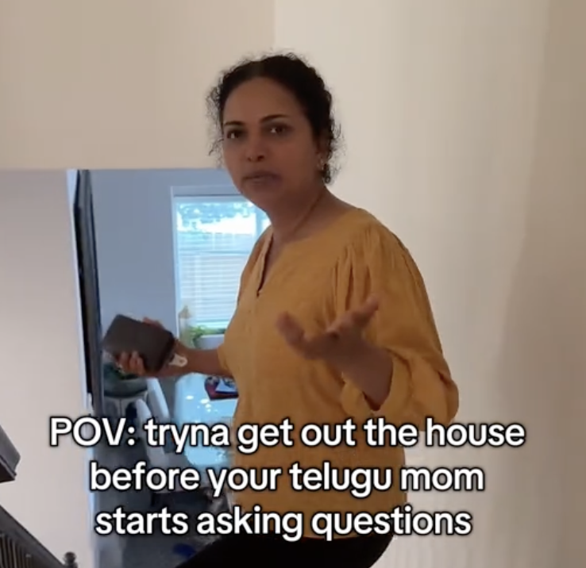
Spoken Telugu
Nearly all native words end in vowels and feel like they rhyme.
Sounds quite flowing, has often been compared to Italian.
Vowel harmony – vowels in the words change to match each other during agglutinisation. Unique feature!
pani (work) -> panulu (works)
Phonetically very, very precise. One tiny change of sound and you’ll send all the mums around howling in laughter. Plus, they love tricking you into saying tongue twisters to get an opportunity to laugh.
గాదెలోన కందిపప్పు గాదెకింద పందికొక్కు!
(Lentils in the rooms,
bandicoots under the room ☺)
Yelling mums will tell you very precisely what they mean but they sure don’t sound that poetic…

Slide 8
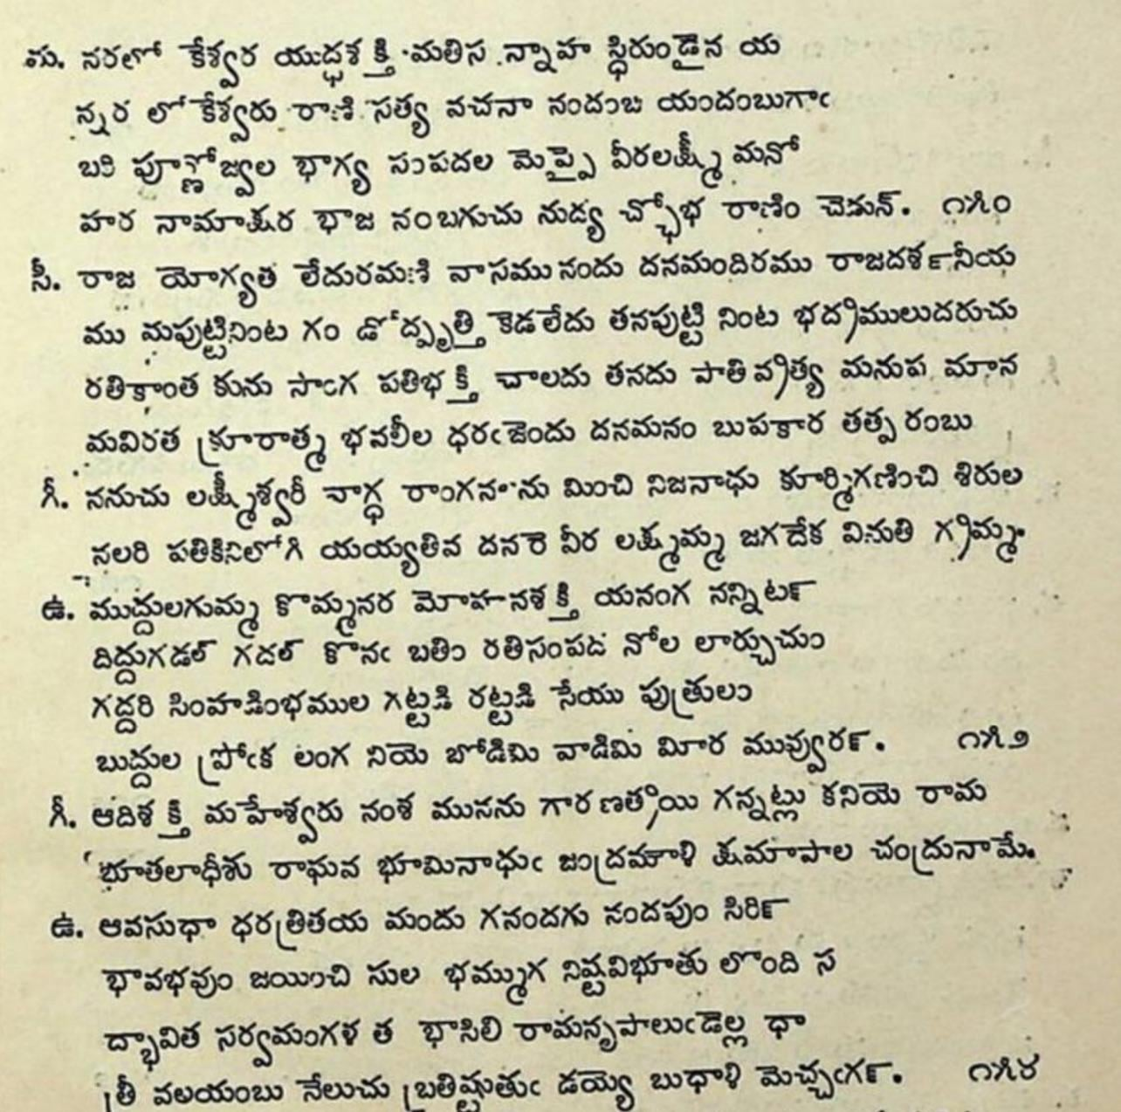
Telugu script
Phonetic, 52-56 characters
Branched off Brahmi script
Rounded and beautiful, curved letters. Hard angles in the letters would have meant tearing through the delicate dried palm leaves that used to be the classical writing material.
Every written character is a syllable, can be modified with marks to signal the exact sound.
"What You See Is What You Get" (WYSIWYG)
Similar to Kannada but you will find similarities across the script family.

Slide 9
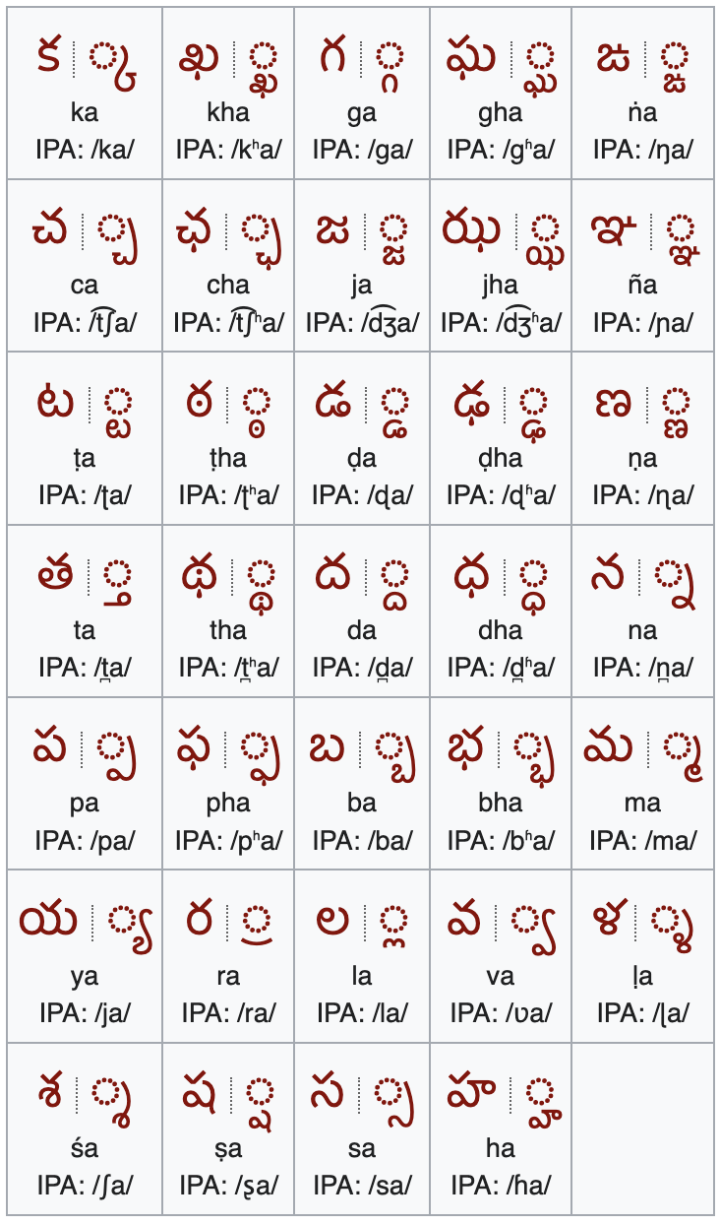
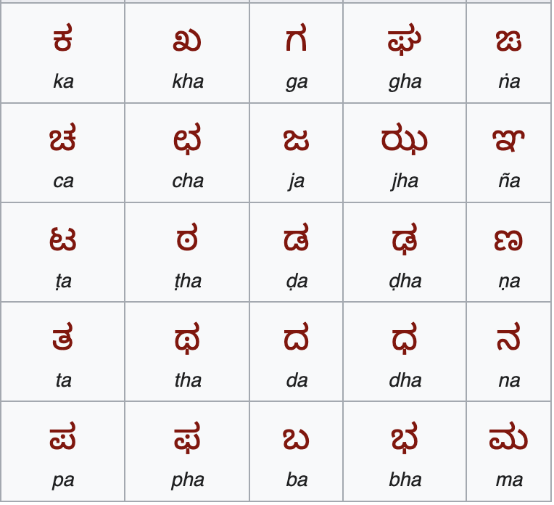
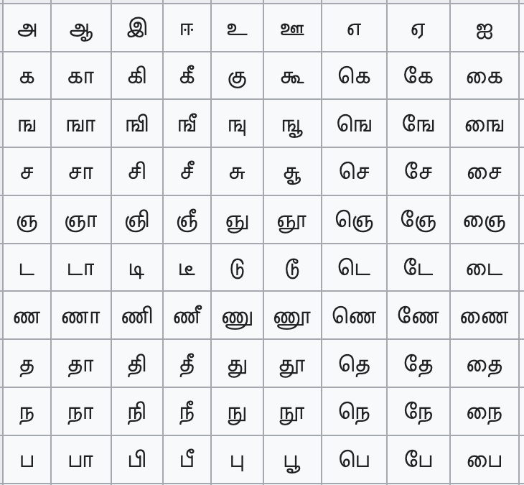
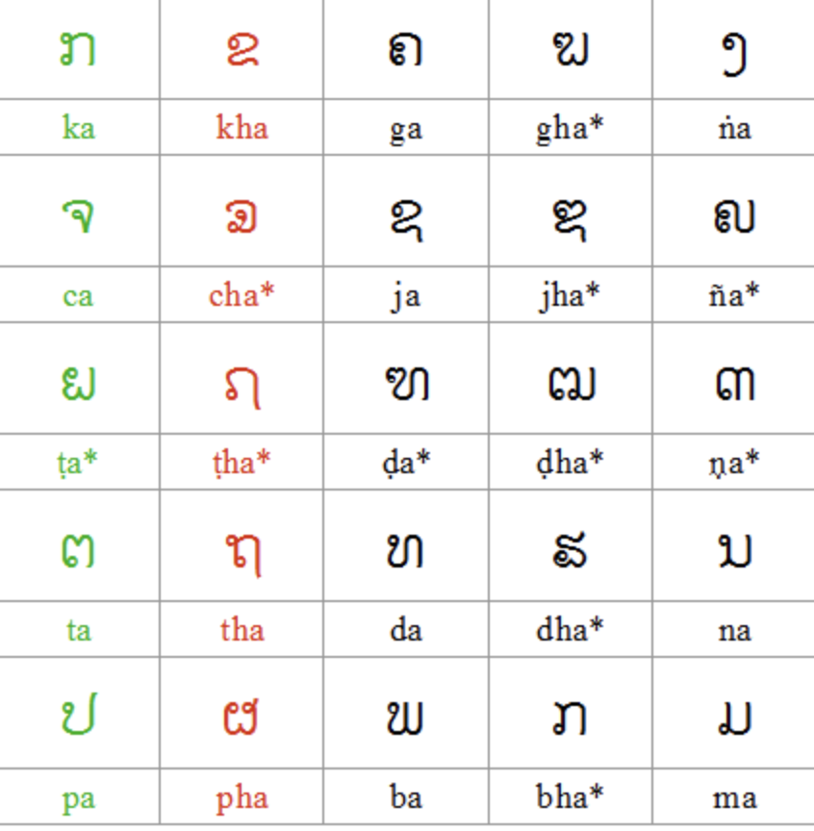
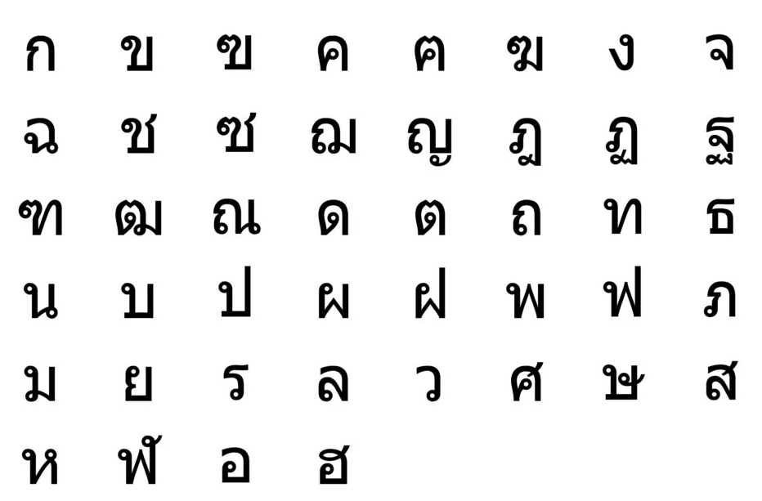
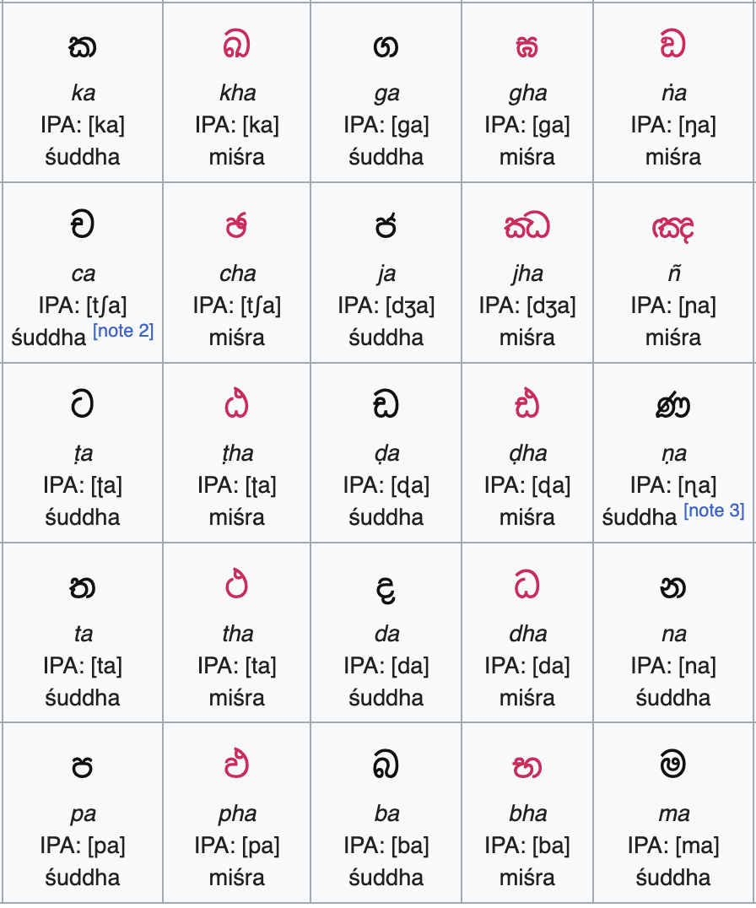
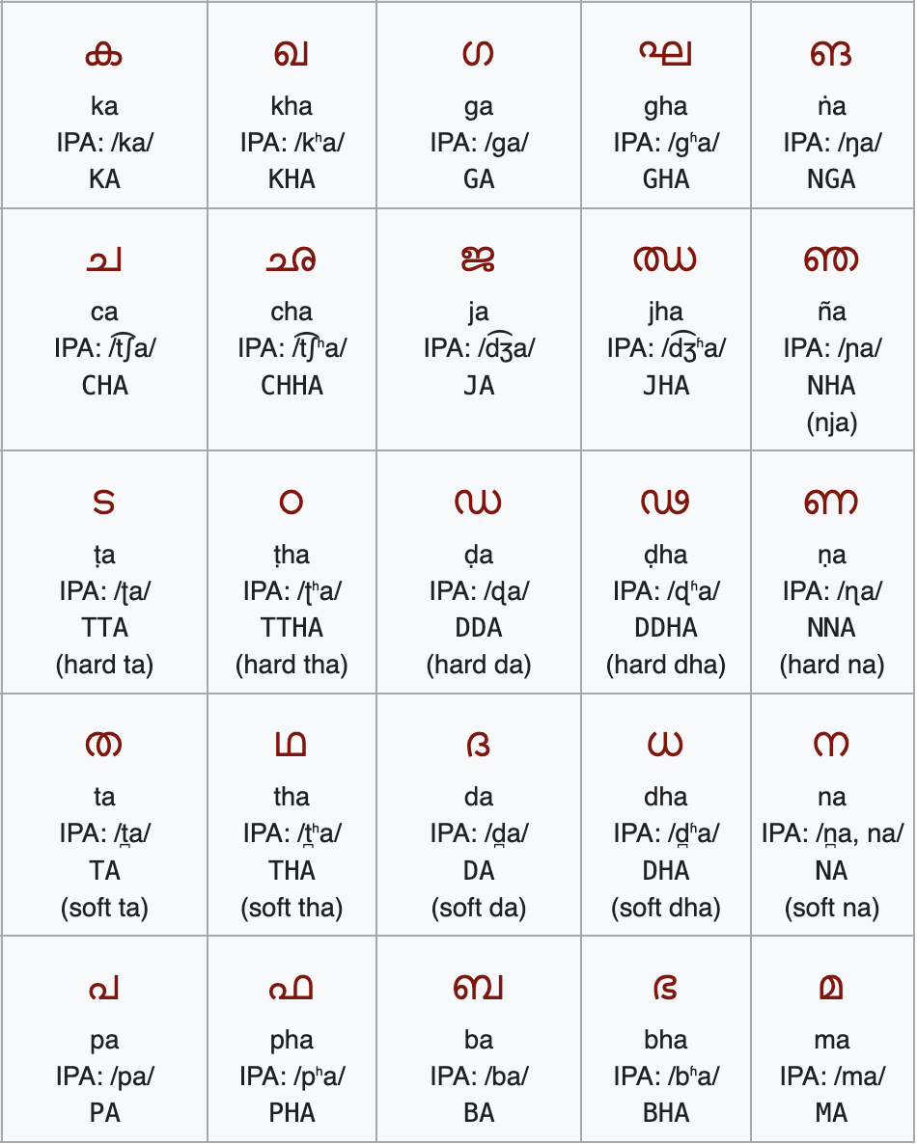
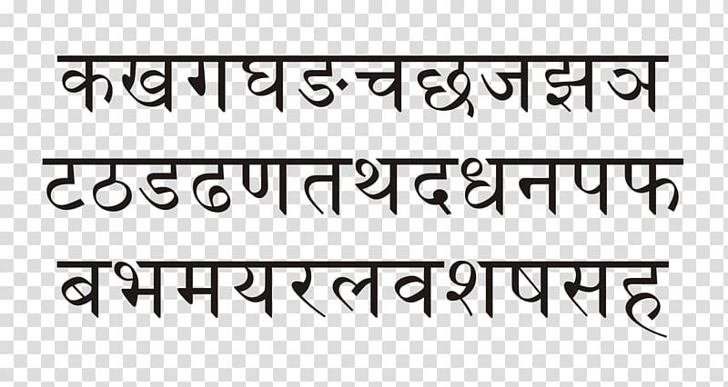
Lao
Kannada
Tamil
Thai
Telugu
Hindi - Devanagari script
Sinhalese
Malayalam

Slide 10
What does the future hold?
Like every other language, Telugu is still evolving, especially as Telugu people go overseas
(And our mums are really savvy…!)
Number of speakers are steady despite diaspora going to non-Telugu places
(Did I mention those savvy Telugu mums before this?)
But several regional dialects, words, cultural assets, stories, family lore are steadily being eroded. Hopefully, our people are collectively strong enough to preserve what is good about the language and culture.

Slide 11
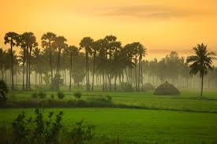
Thank you!

